Slide 1
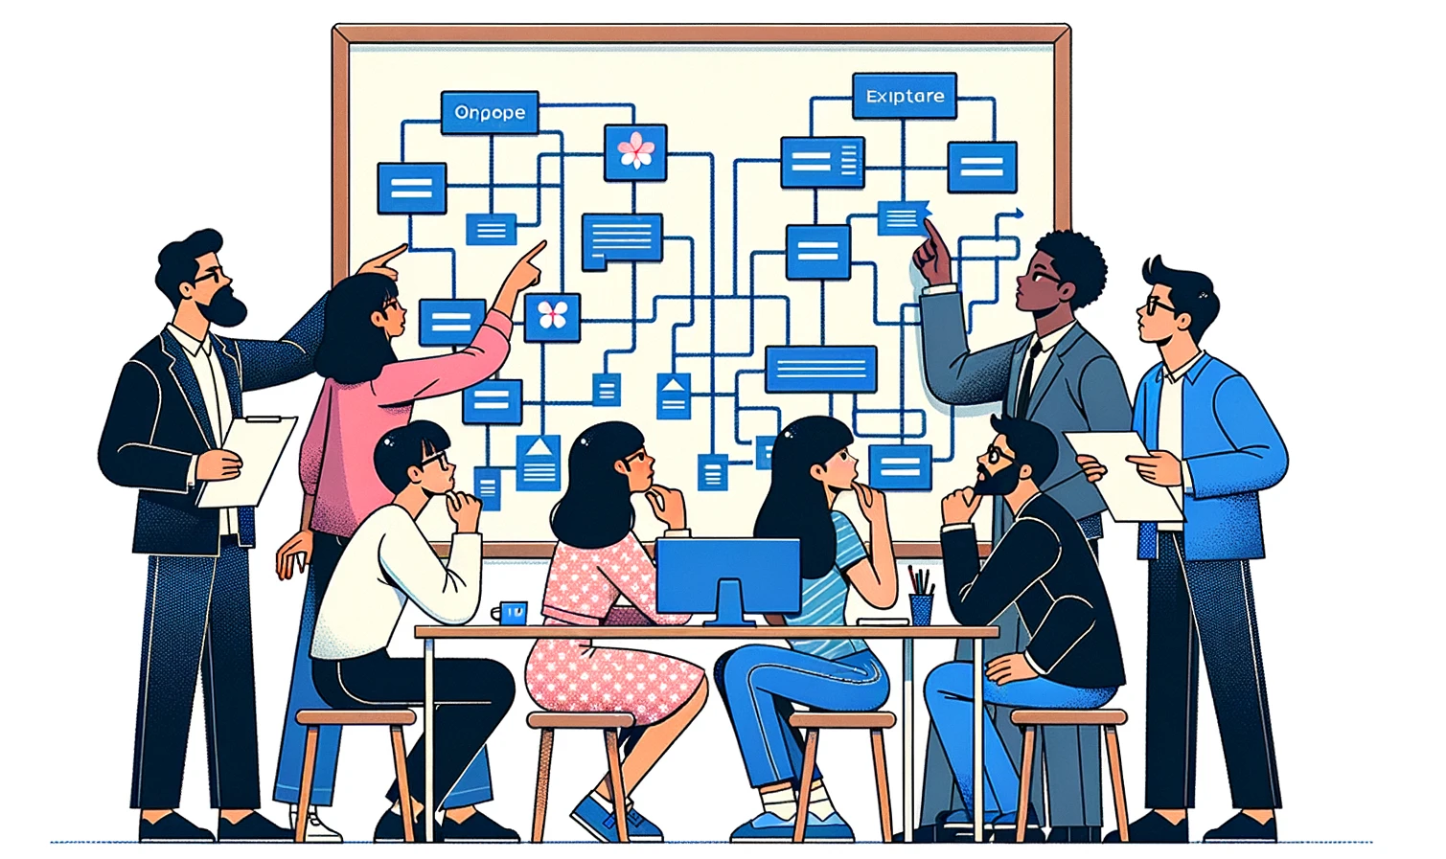
Generative Patterns for AI
Foundations of AI Acceleration
Dan McCreary and Steve Peterson
November 2023

Slide 2
Talk Description
Generative AI is by far the most impactful technology in the last ten years. It dominates the priority list of almost every CIO in the world.
This session will review key architectural patterns that organizations are using to safely harness the power of Generative AI to build intelligent search, chatbots and agents as well as performing a variety of tasks on unstructured text.
We will cover the key use case taxonomies that are emerging and the architectural patterns we need to support these initiatives. If implemented, these patterns can accelerate the process of building intelligent agents for all knowledge workers.

Slide 3


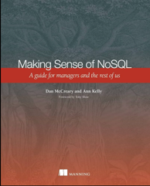





Background for Dan McCreary
Solution architect with over 35 years working with data
Worked for Bell Labs and Steve Jobs at NeXT
Author of a book on database selection “Making Sense of NoSQL”
Promoter of XML and graph query standards (GQL)
Former Distinguished Engineer working for Optum (UHG)
Built the worlds largest healthcare knowledge graph
Lead the “Generative AI Center of Excellence” at Optum
Worked with over 250 healthcare uses cases – 50 which were funded and over 10 in production
Blogger: http://medium.com/@dmccreary
Big fan of AI, robotics, MicroPython, and STEM education
Advocate for neurodiversity

Slide 4

Background for Steve Peterson
Steve Peterson
Senior Director of Enterprise Architecture
Rodan + Fields.
Steve brings over three decades of expertise in spearheading enterprise architecture initiatives. His career has seen pivotal roles at industry giants such as IBM, Be The Match, UnitedHealthcare (UHC) & Optum, and AT&T. At UHC, Steve's visionary leadership in Enterprise Architecture was evident as he crafted strategic roadmaps, particularly emphasizing innovations in integration, chatbots, and Natural Language Processing.

Slide 5
Outline
What is an architectural pattern?
Why are they important for discussing architecture tradeoffs?
Building on Enterprise Integration Patterns (EIP)
Key patterns:
Finetuning
Prompt Enrichment (RAG)
Embeddings
Concept Index (vector store)

Slide 6


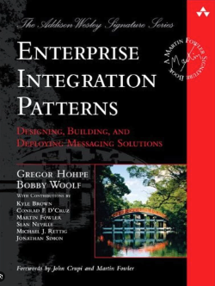
What is an Architectural Pattern?
A general, reusable solution to a commonly occurring problem in software architecture within a particular context
A named way of moving from problem to solution

Slide 7
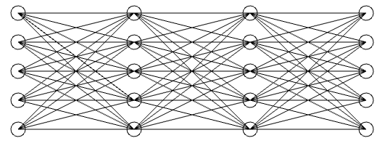
Abstractions and Subsystems
Architectural patterns are high-level abstractions that provides a set of predefined subsystems, their responsibilities, and rules for organizing the relationships between them.
Prompt
Response
Large-Language
Model

Slide 8


Patterns and Bandwidth
Architecture patterns help in laying out the structure for a software system and provide a vocabulary for discussing system design
Precise design patterns create high-bandwidth discussions that help architects quickly understand design tradeoffs
Notes:
Create an image of two business professionals standing in an open space. They are standing far apart. The Asian woman on the left is talking into a cup. The dark skinned man on the right is listening to a cup at his ear. There is a tight string between the two cups. The string is straight. There is nothing in the background.

Slide 9
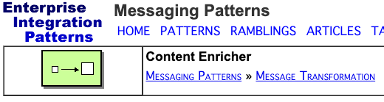
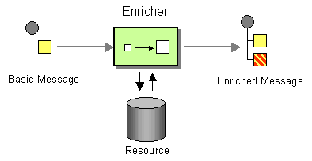
Architecture Patterns Have Diagrams
Good architecture patterns have clear diagrams that have common meaning
New patterns can be derived from similar patterns
Example EIP Pattern: Content Enrichment
https://www.enterpriseintegrationpatterns.com/patterns/messaging/DataEnricher.html

Slide 10
Prompt Enrichment
By using similar terminology that architects are already familiar with, we can quickly build new patterns
Basic Prompt
Enriched Prompt

Slide 11
Architecture Tradeoff Analysis
Business
Drivers
Quality
Attributes
User
Stories
Analysis
Architecture Plan
Architectural
Approaches
Architectural
Decisions
Tradeoffs
Impacts
Sensitivity
Points
Non-Risks
Distilled info
Risk Themes
Risks
This process defined by CMU's Software Engineering Institute

Slide 12
Example: Databases Architectures
Relational
Analytical (OLAP)
Key-Value
key
value
key
value
key
value
key
value
Column-Family
Graph
Document

Slide 13
Architecture Tradeoffs in Generative AI
Finetune or Prompt Enrichment?
Small model or large model?
Response time or high quality?
Vector databases or graph database?

Slide 14
Questions
Thank You!
LinkedIn: https://www.linkedin.com/in/danmccreary
Blog: http://medium.com/@dmccreary

